Slide 1
VIVO Architecture

Slide 2
Software architecture overview
https://wiki.duraspace.org/display/VIVODOC110x/Software+Architecture+Overview

Slide 3
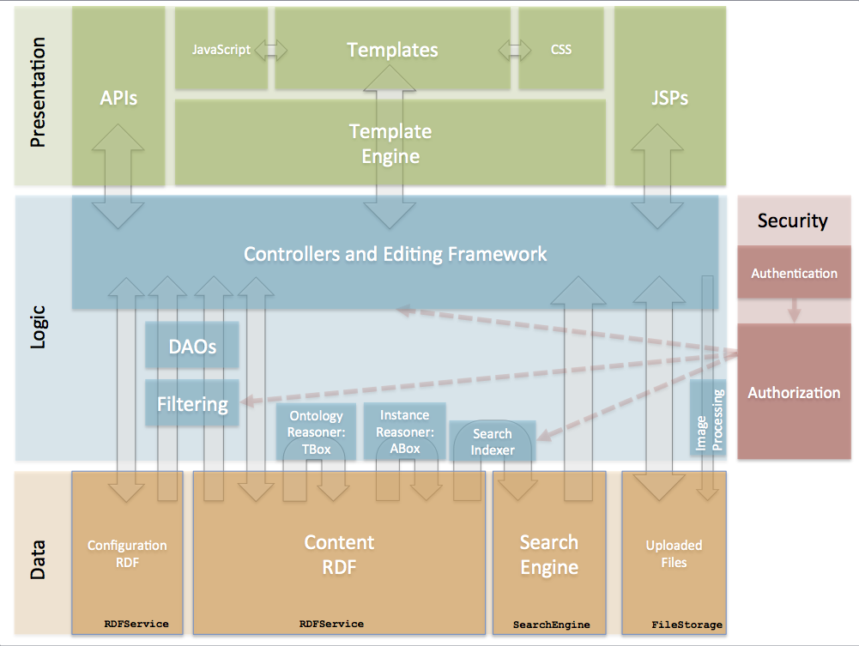

Slide 4
VIVO and Vitro
VIVO is a customization of Vitro
Vitro – A general-purpose tool for working with Semantic Data.
VIVO – A specialized tool for Research Networking
https://wiki.duraspace.org/display/VIVOv17x/Changing+the+appearance+of+VIVO

Slide 5
VIVO vs. Vitro
Vitro | VIVO
No ontology | Includes an ontology for Research Networking
Minimal theme | Rich theme.
Default display rules | Annotations are used to: Assign data properties to groups Arrange property groups on the page
Default permissions | Display and editing permissions are customized, based on the ontology
Default editing forms | Editing is customized to the ontology
Default search index | Search index contains additional fields, specific to VIVO
Default functionality | Additional functionality: visualizations, interface to Harvester, QR codes, etc.

Slide 6
VIVO: a wrapper over Vitro
*Represents VIVO 1.7

Slide 7
A third tier?
Scholars@Cornell
For example:
Is a customization of
VIVO
Is a customization of
Vitro
https://github.com/vivo-community/vivo-project-template/tree/maint-rel-1.9.3

